Slide 1
An Introduction to Python
Day 1
Renaud Dessalles
_{dessalles@ucla.edu}

Slide 2
Why Python?
Clear code
Great beginner language
Powerful text manipulation
Wrangle large data files
Great compliment to other languages
Large user group
Supports many advanced features
Notes:
Advanced features: object orientated

Slide 3
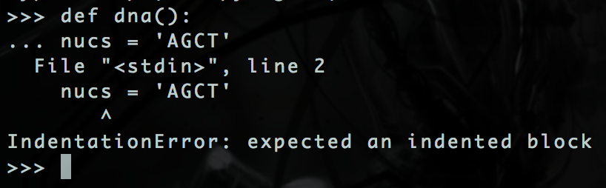
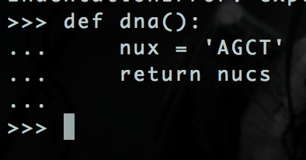
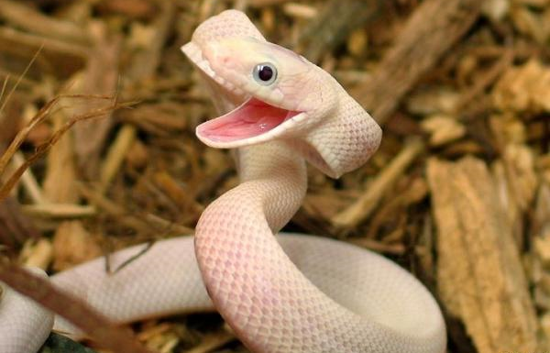
Warning: Spacing is important!
Wrong: Error:
Correct: No Error:
Tip: Use TAB key
Notes:
Advanced features: object orientated

Slide 4
First steps

Slide 5
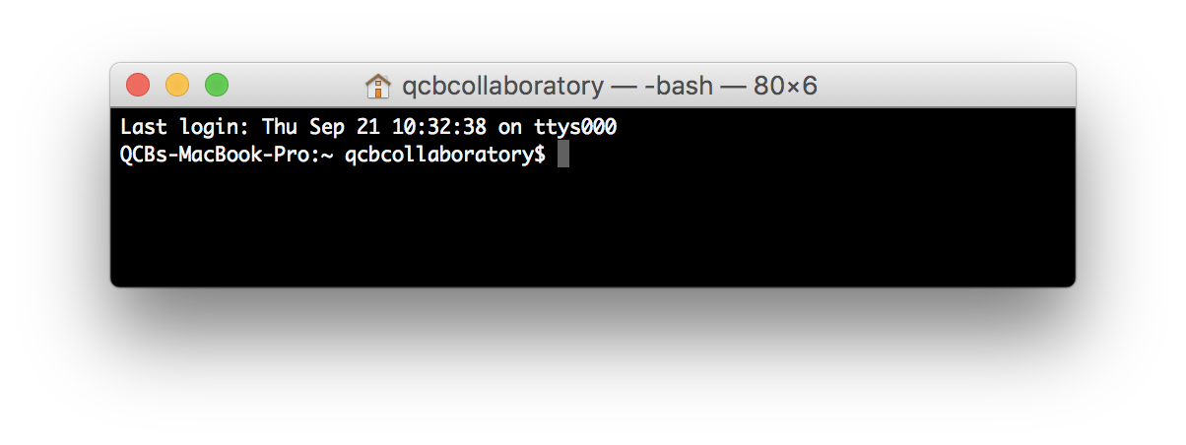
Open A Terminal
Open a terminal:
Mac: cmd + space then type terminal and press enter
Windows: Start -> Program Files -> Accessories -> Command Prompt.
Ubuntu: Ctrl+Alt+T
Notes:
Advanced features: object orientated

Slide 6
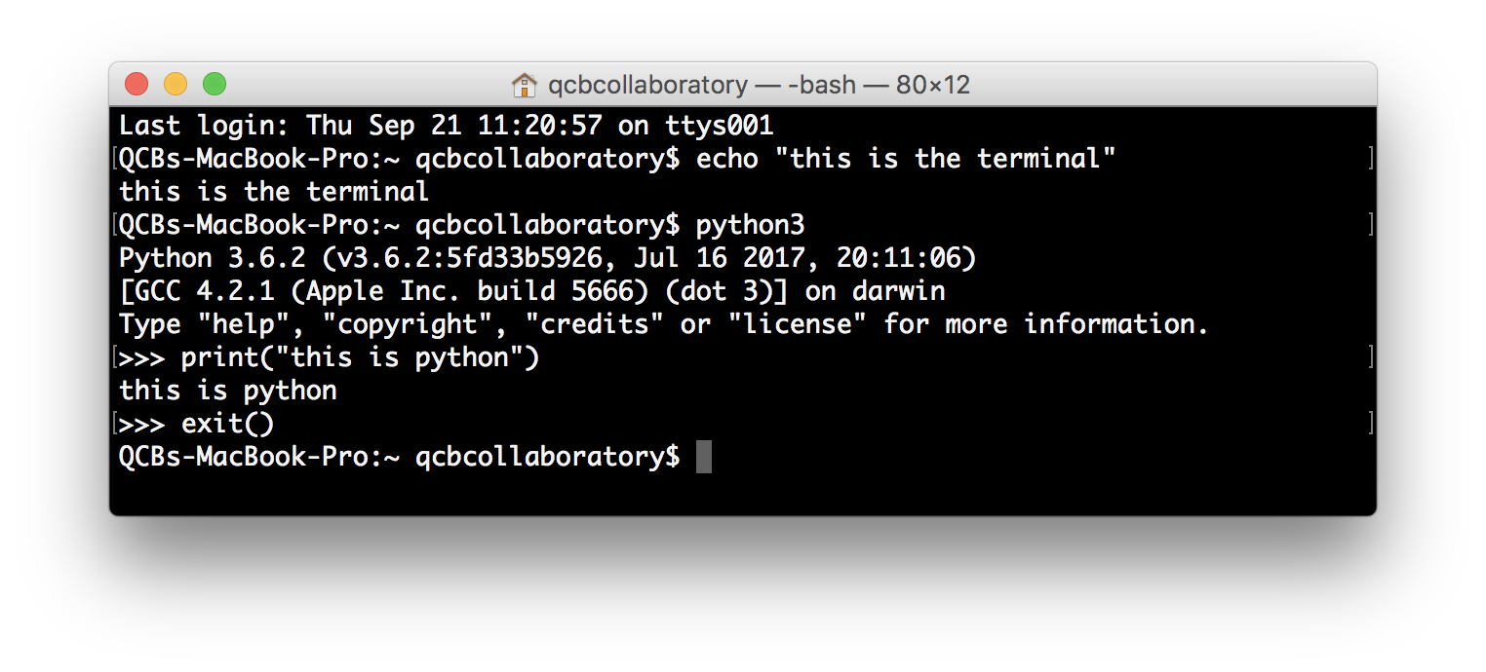
Open Python3
Open Python3: type python3 (or python if it does not work)
Exit Python: type exit()
This is python
Notes:
Advanced features: object orientated

Slide 7
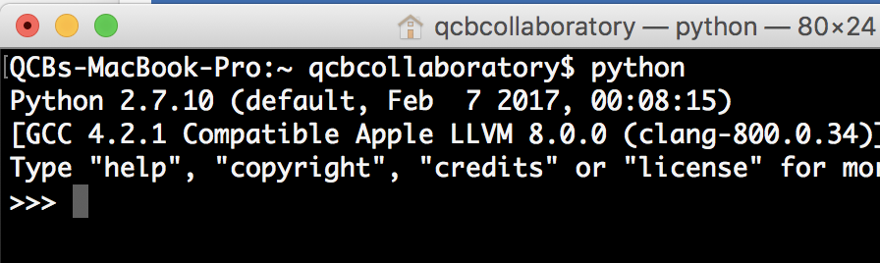
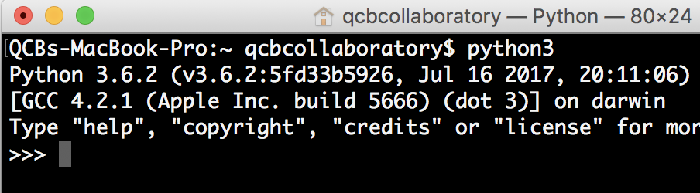
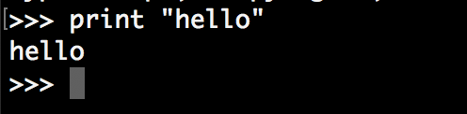
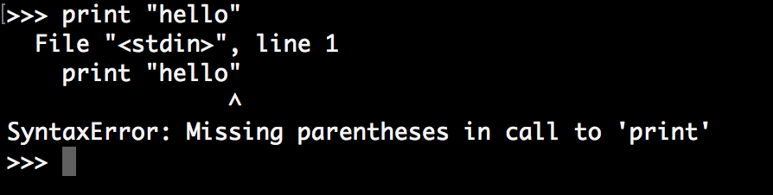
Python2 vs Python3
Type: python or python2
Type: python3
Python 2
Python 3
Differences between the two versions

Slide 8
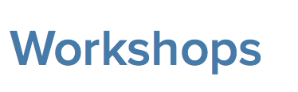
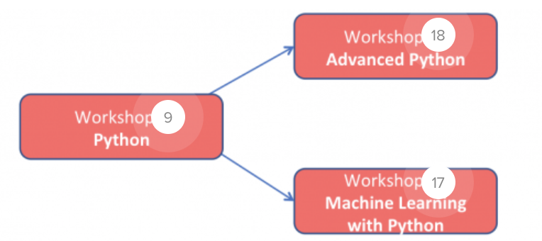
Why working with Python3?
It is the future ☺
Autocomplete in the interpreter (with TAB key)
UTF-8 by default (Je suis Français)
More and more libraries soon not compatible with Python2
Python3 used in the next Workshops
In this workshop: work mainly with Python3
Often the code is compatible with Python2
Will show the main differences with Python2.

Slide 9
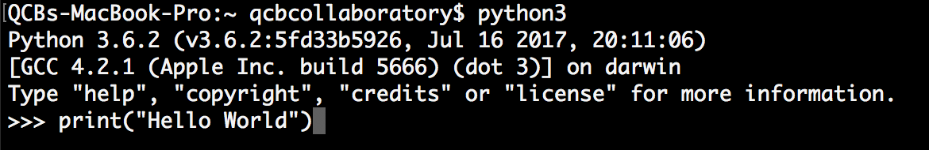
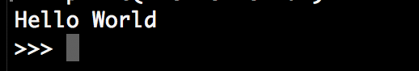

Hello World
Launch Python, type print(“Hello World”)
Call the built in function print, which displays whatever comes after the command.
Put any message in quotes after the print command.
Then press Return
The command has finished and python is ready for the next command. means: “tell me what to do now!"
Notes:
Advanced features: object orientated

Slide 10
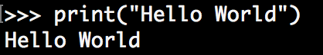
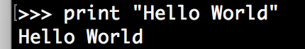
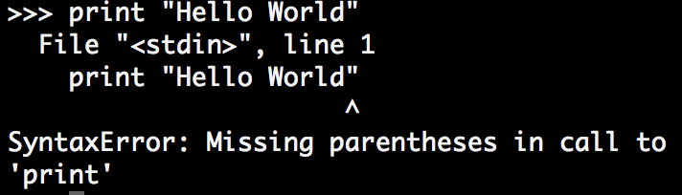
Python2 vs 3: Print function
Python2
Syntax with brackets
Syntax without brackets
Python3
Syntax with brackets
Syntax without brackets: Error !!!

Slide 11
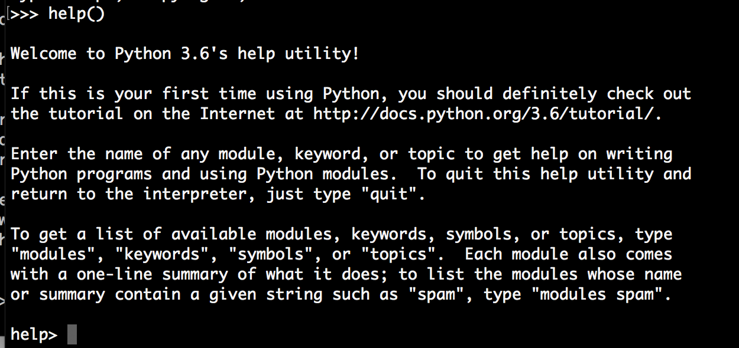
Getting help - interactive

Slide 12
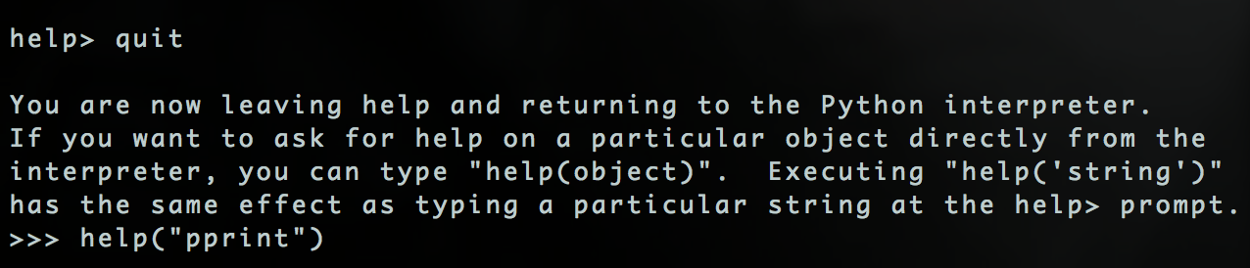
Getting help – single command
But usually just Google!
If you got stuck on something, someone else probably has.

Slide 13
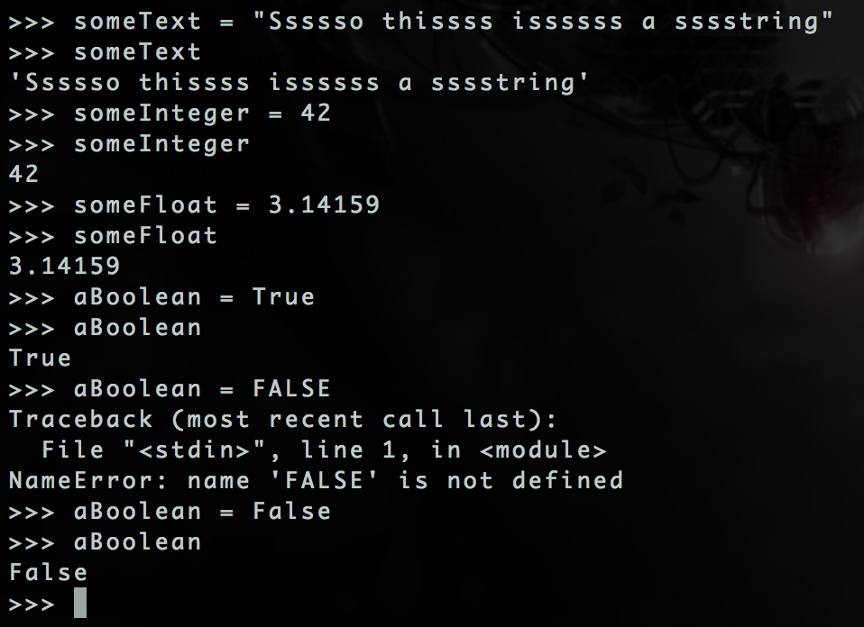
Let’s get programming - Variables
Set a variable with equals
Display a variable by typing its name
Variables can be text, numbers, boolean (True/False) and many more things.
Capitalization is important for True/False

Slide 14
Working with numbers

Slide 15
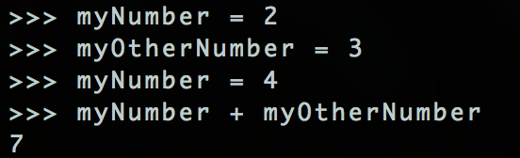
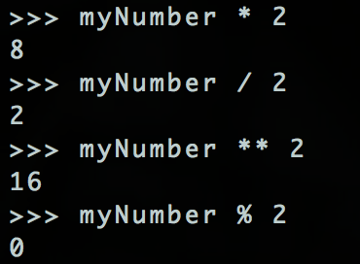
Numeric Operators
Add +
Subtract –
Multiply *
Divide /
Power **
Modulo (remainder) %
Notes:
Notice mynumber stays consistent

Slide 16
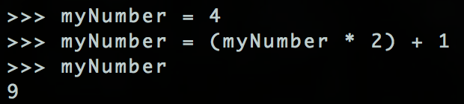
Reassigning Variables
Reassign with equals.
(Same as assigning)
?????

Slide 17
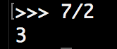
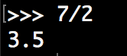
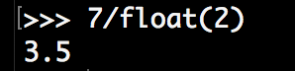
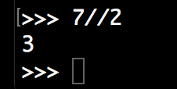
Python2 vs 3: Division of integers
Python2
Division of integers, Euclidian division
Use float on o\ne of the integers for a float division
Python3
Division of integers, float division
Use two slashes ∕ ∕ for the Euclidian division

Slide 18
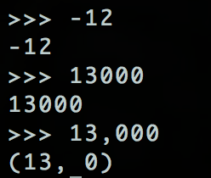
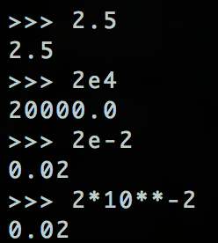
Types of number
Integer:
Plus and minus.
No decimal points or commas
Float:
Decimal points or scientific notation okay.
2e-2 = 2 x 10⁻²

Slide 19
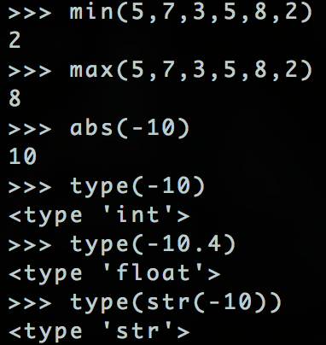
Working With Numbers
What is the minimum of these numbers:
What is the maximum of these numbers:
What type of variable is this?
Remember that str(anything) makes that variable into a string:

Slide 20
Working with texts

Slide 21
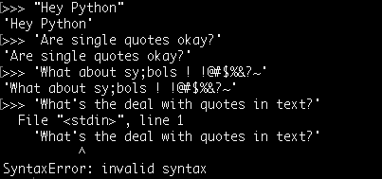
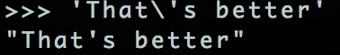
Working With Text
Single or double quotes.
No char type. Just a single letter string.
Escape character is \
\’ types a quote.

Slide 22
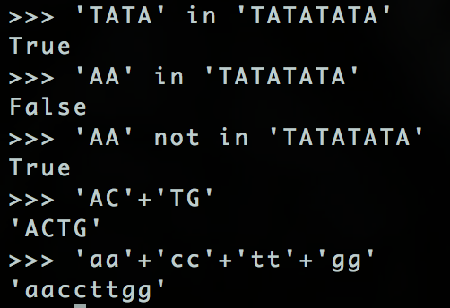
Working With Text 2
Is a substring in a string?
Is a substring NOT in a string?
String concatenation:

Slide 23
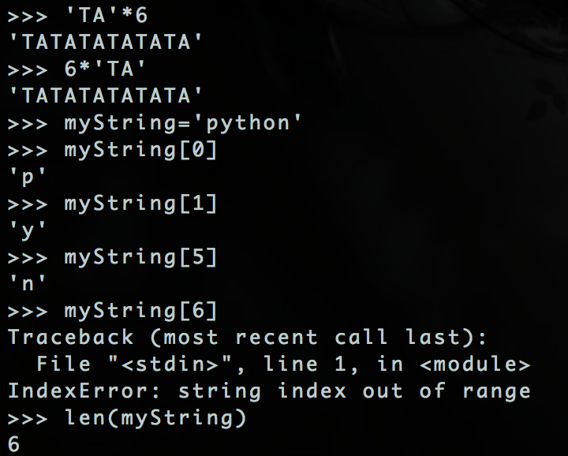
Working With Text 3
Multiply a string repeats it:
Set variable myString to be ‘python’
Each character in a string is a number
We start counting from zero!
“String index out of range” error as we tried to reference a character beyond the end of the string.
len(myString) gets the number of characters.

Slide 24
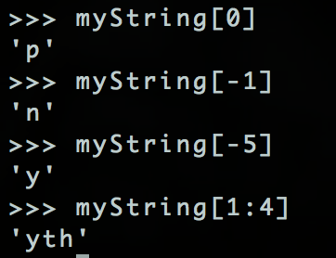
Working With Text 4
Negative index counts backwards from the last element.
You can get a range of characters from a string.

Slide 25
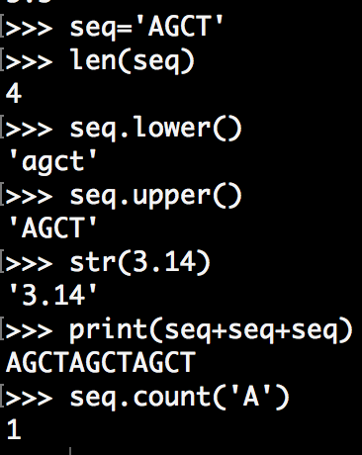
Working With Text 4
Set the variable seq to be ‘AGCT’:
Get the number of characters in seq:
Return the variable seq in all lower case characters:
Return the variable seq in all upper case characters:
Return the number 3.14 as a string:
Display the variable seq repeated 3 times:
Count the occurrences of ‘A’ in seq:

Slide 26
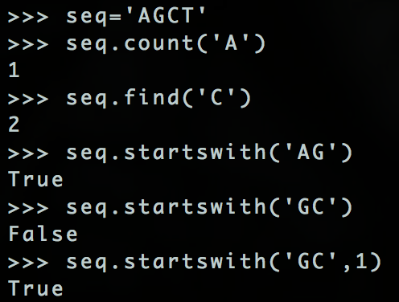
Working With Text 5
Set the variable seq to be ‘AGCT’:
Count the occurrences of ‘A’ in seq:
Find which index in seq contains ‘C’
Does seq start with ‘AG’
Does seq start with ‘GC’
Does seq start with ‘GC’ if you start at the second letter.

Slide 27
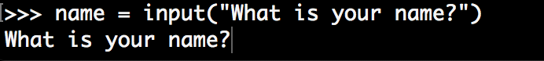
Python2 vs 3: Text input
To ask some information from the user, use of an input function:
Python2: Function raw_input
Python3: Function input
Prints the text in quotes and waits for user input.
Sets the variable on the left of to whatever the user types.

Slide 28
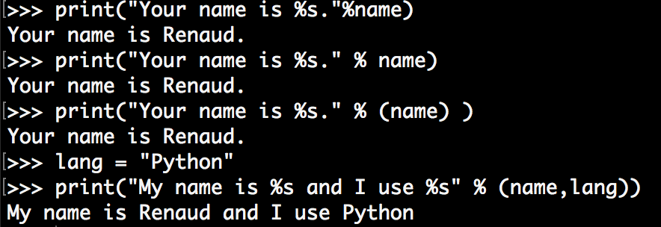
Working With Text 6
print(“%s” % text-here)
Place a %s in a string to place a variable at that point in the string. The variables are given in order after a %.

Slide 29
Type of variables

Slide 30
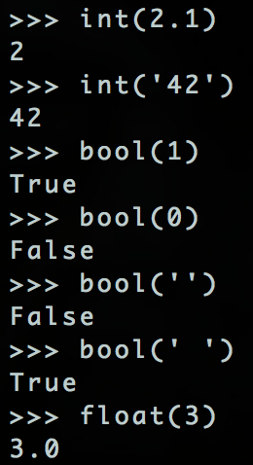
Changing a Variables Type
Cast a variable to another type.
Note:
1 = True
0 = False
Empty strings = False
Any other string = True

Slide 31
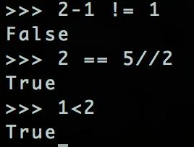
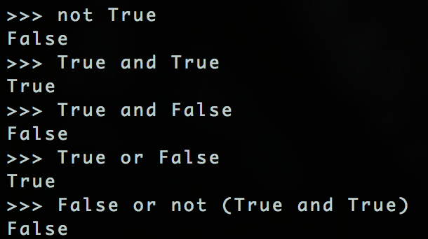
True/False – conditional expressions
Equal to (==)
Not equal to (!=)
Less than (<)
Less than or equal to <=
Greater than (>)
Greater than or equal to (>=)
not
and
or

Slide 32
If-else statements

Slide 33
If statement
If-else statement
Main program statements
Conditional block of commands
if
True
if
True
False
False
else
Continue main program

Slide 34
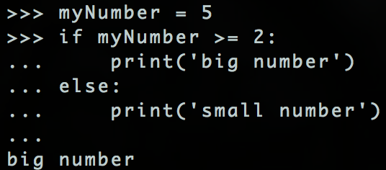
If Else Statements.

Slide 35
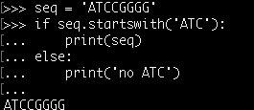
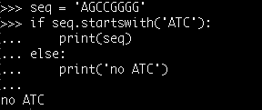
If Else Statements

Slide 36
Functions

Slide 37
Write Code Once and Reuse
FUNCTIONS
Might want to run the same code on million of sequences.
Write a function once and use it whenever you have to do that task.
def function_name(parameter1,parameter2):
any
code
here
return result_of_function

Slide 38
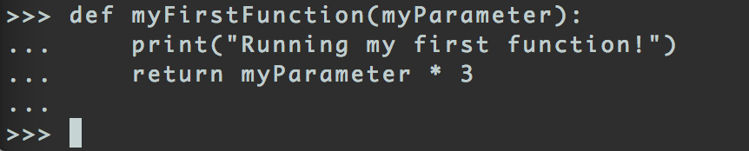
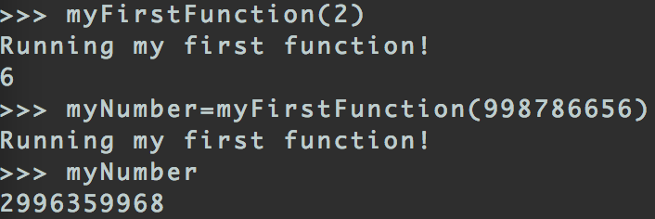
Write Your First Function
Returned values can be assigned to variables outside functions.

Slide 39
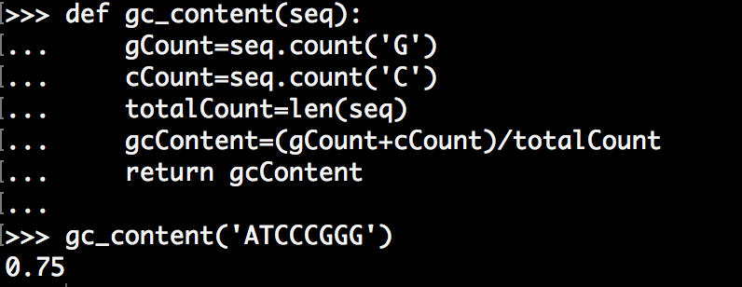
Your First USEFUL Function
Calculating GC Content:
Let’s write pseudocode
Input is a sequence
count G occurrences
count C occurrences
sum G and C occurrences
divide the sum by the total sequence length
return the result

Slide 40
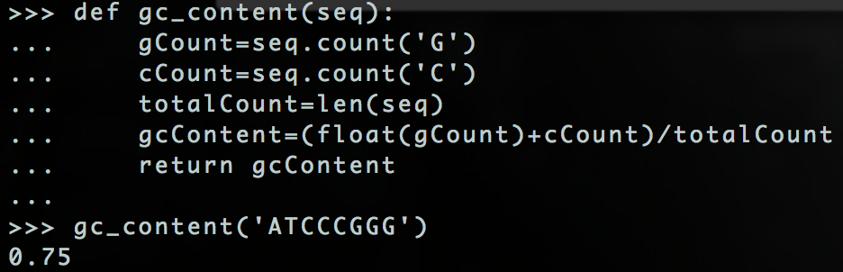
Python2 vs 3: Who gets the right result?
Remember the integer division problem on Python 2 ??
On Python2

Slide 41
3 Ways to Run Python Code
Interactive environment
What we’ve been doing
Modules
Groups of functions loaded into the interactive python session.
Scripts
Run python code from outside the interactive python session. Typed into the Windows/OS X/Unix command line.

Slide 42
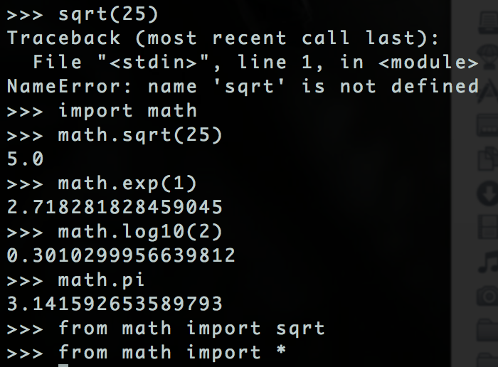
Importing Generic Modules
import MODULENAME
from MODULENAME import FUNCTION
from MODULENAME import *
(everything - caution)

Slide 43
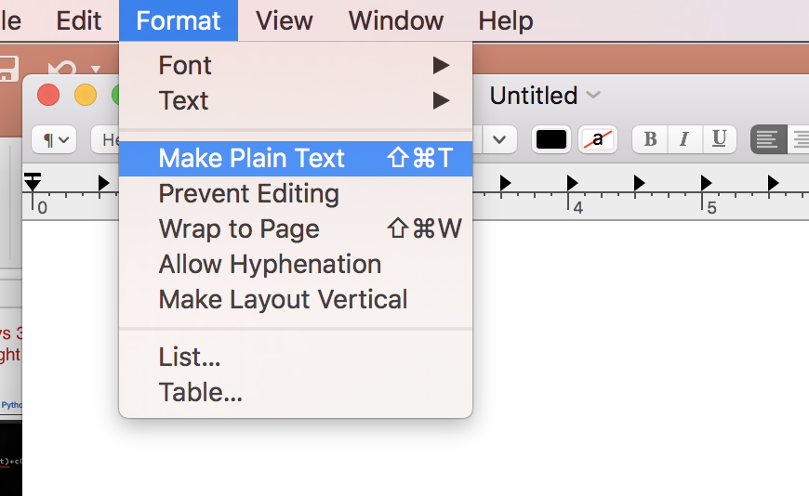

Working in a Text Editor
Typing everything into the python environment can be inconvenient.
Write your code into a text document
Use a basic text editor
Notepad (windows)
TextEdit (Mac)
emacs/Vim/gedit (Ubuntu)
Save with a .py extension.
Careful with TextEdit on Mac!
TextEdit on Mac

Slide 44
Combining Everything We’ve Learnt
Let’s write a function that:
Takes a sequence as a parameter
Prints the sequence if it starts with ATC
If the sequence starts with AGC prints ‘Starting with AGC’.
If the sequence starts with neither print ‘Starting with neither ATC or AGC’.

Slide 45


In home directory
File extension .py
(not .txt or .py.txt, etc)

